Slide 1


Lesson 1
The Software Development Lifecycle
Developing software is a complex process. In this presentation, we'll cover everything you need to know about the software development lifecycle, from planning to maintenance.
AB
by Adaeze Badipe
LO: Understand Different Stages of Software Development Lifecycle (Intro)

Slide 2
Introduction
Before we dive into the details, let's take a look at why the software development lifecycle is important. Whether you're building a new app or updating an existing one, following a structured development process ensures that you deliver high-quality software that meets the user's needs.

Slide 3
Overview
What is the Software Development Lifecycle?
Why is it important?
What are the key phases?
Following a structured development process ensures the end product meets the user's needs. It also helps to stay within scope and budget and reduces the risk of errors.
The software development lifecycle consists of planning, design, implementation, testing, deployment, and maintenance phases.
The software development lifecycle is a process that outlines the steps involved in building software. Each step is crucial and must be completed before moving onto the next one.

Slide 4
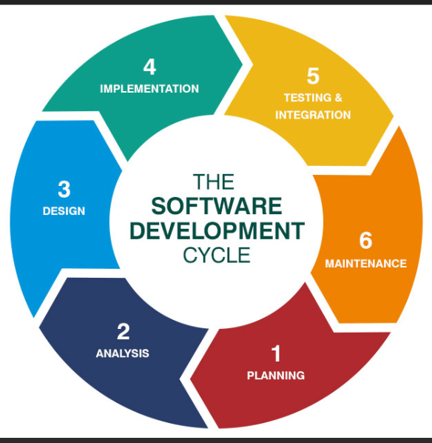
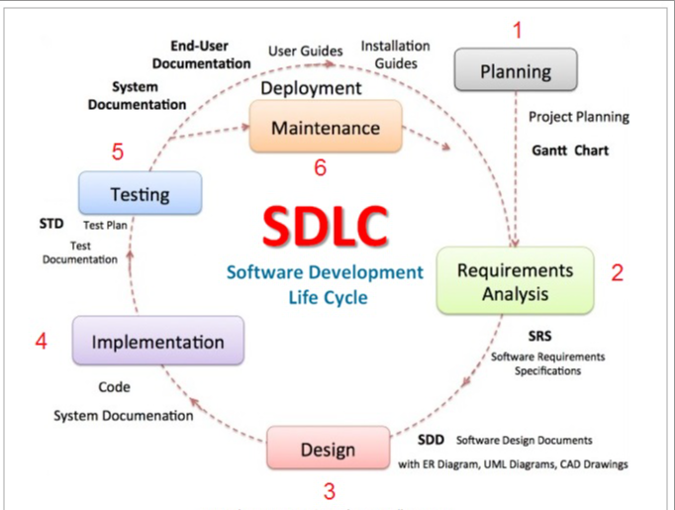
Key Phases of Software Development Lifecycle (SDLC)
Examples:

Slide 5
Key Phases of Software Development Lifecycle (SDLC)
Explore different SDLC diagrams Online:
What did you observe?

Slide 6
Planning Phase
1
2
3
4
Gather Requirements
Design Architecture
Create Project Plan
Obtain Approvals
Identify the user's needs, what they expect, and define the scope of your project.
Develop a high-level architecture that identifies all the components required in the system.
Develop a detailed project plan that includes a timeline, budget, and resource allocation for all project activities.
Get approvals from stakeholders on the requirements, scope, and project plan. The planning phase is complete once all approvals are obtained.

Slide 7
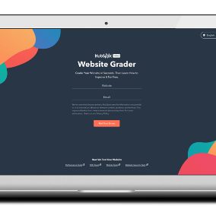
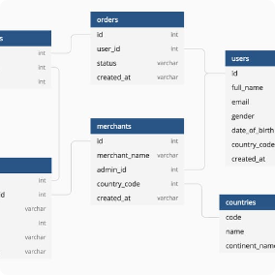
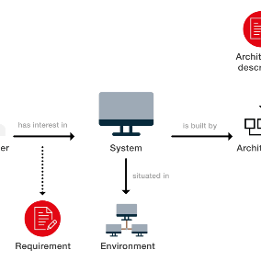
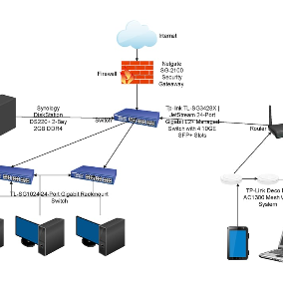
Design Phase
UI/UX Design
Database Design
System Architecture
Create a design that meets the user's needs, is intuitive, and visually appealing.
Design a database that stores the data required for the system, including tables, fields, and relationships.
Design a detailed system architecture that identifies all the interfaces, interactions, and dependencies between system components.
Network Design
Design a network architecture that supports the system's requirements and ensures optimal performance and security.

Slide 8
Implementation Phase
Unit Testing
Test each component of the system to ensure it works as expected and meets the requirements.
1
2
3
Code Development
Integration Testing
Develop the code that implements the system's functionality and meets the design.
Test the assembled components to ensure they work together and meet the requirements.

Slide 9

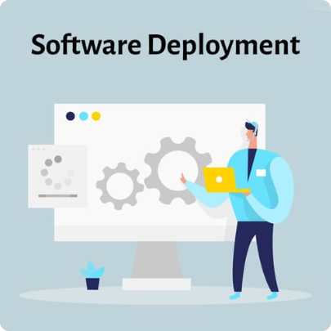
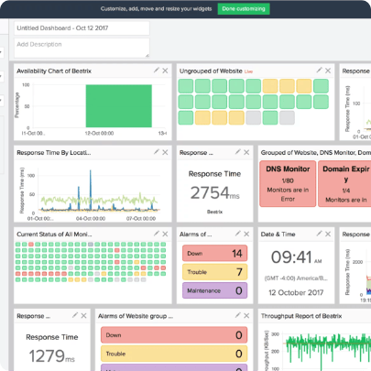
Testing and Deployment
Testing
Deployment
Monitoring
4 types of testing: functional, performance, unit, and integration. Testing ensures the system meets requirements, is secure, and performs well.
Deploy the system in the live environment following an organized process that includes a rollback plan if something goes wrong.
Monitor the system once deployed for performance, security, and user feedback.

Slide 10

Maintenance Phase
1
Support
2
Enhancements
3
Bug Fixes
Provide support for the system to users, resolve issues, and continue to improve the system.
Add new features and functionality to the system to enhance its capabilities and ensure it continues to meet user requirements
Identify and fix any bugs found in the system during the maintenance phase.

Slide 11

Conclusion
The software development lifecycle is a process that ensures high-quality software delivery, meets user needs, and stays within scope, time, and budget.

Slide 12

Test Your Knowledge
Notes:
http://tinyurl.com/FCOTSDLC

